Slide 1
WHAT’S WORKING IN INTERNAL COMMUNICATIONS & WHY
NORA K. CARR, ED.D., APR
CHIEF OF STAFF
COUNCIL OF THE GREAT CITY SCHOOLS
carrn@gcsnc.com
336-370-8106

Slide 2
What the Research Says
Employees prefer to hear important information from their direct supervisors.
Better employee communication and engagement yield significant (50%) gains in productivity, market value (Watson Wyatt, 2004) and higher employee (44%) retention rates (Durkin; 2007; Izzo & Withers, 2000; Ruck & Welch, 2012)
Supervisor communication has a “substantial influence” on workplace experience and satisfaction; 80% of employees say communication influences their desire to stay or leave an organization (Burton, 2006; Karonges, Johnson, Beatson and Lings, 2015)
Employees rank among the most credible and authentic ambassadors for an organization (Kang & Sung, 2017; Redding, 2013)
Symbolic communication and behavior often speak the loudest (Jiang & Luo, 2018)
Authentic employee engagement, consistency of words and actions and transparency build trust (Jiang & Luo, 2018)
Employee communication preferences vary by role, demographics (Jiang & Men, 2015; Men, 2016, Mickkelson, Hesse & Sloan, 2017)
“When people are financially invested, they want a return. When people are emotionally invested, they want to contribute.”
Simon Sinek

Slide 3
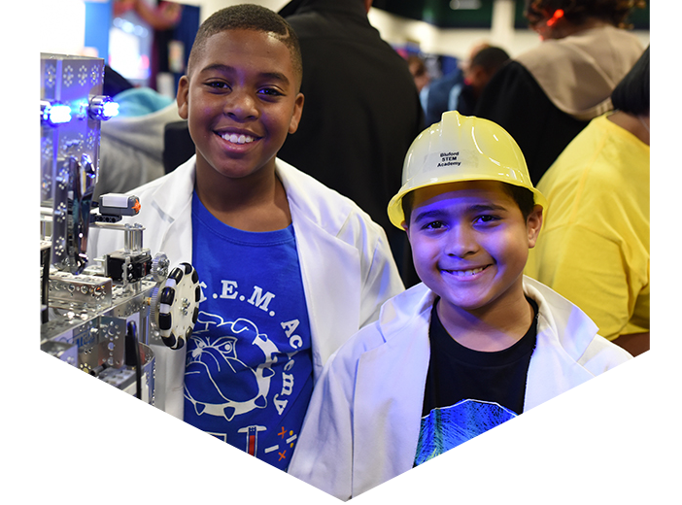
“All employees have an innate desire to contribute to something bigger than themselves.” Jag Randhawa

Slide 4
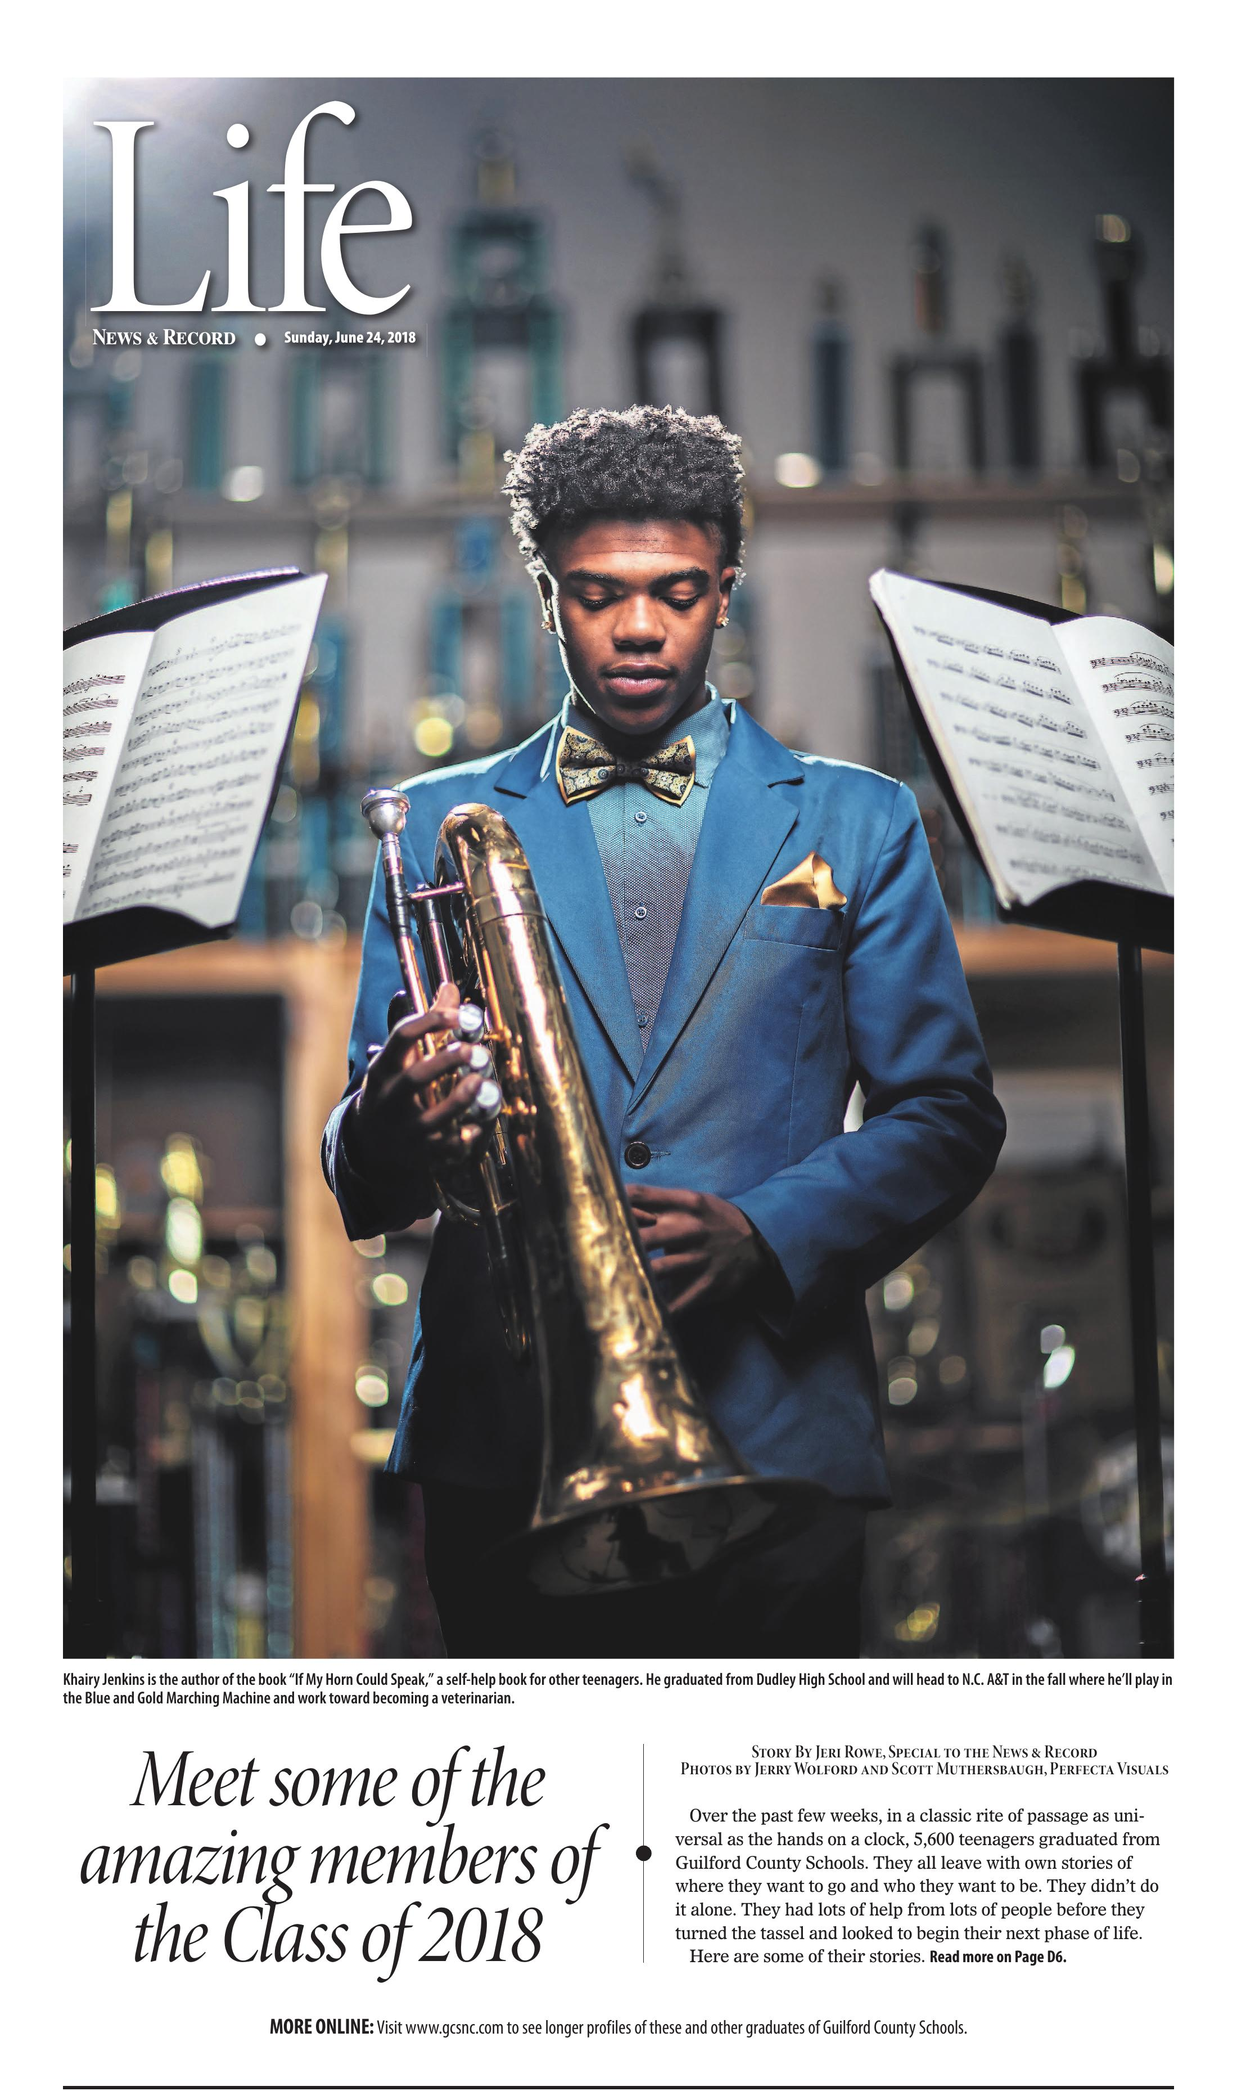
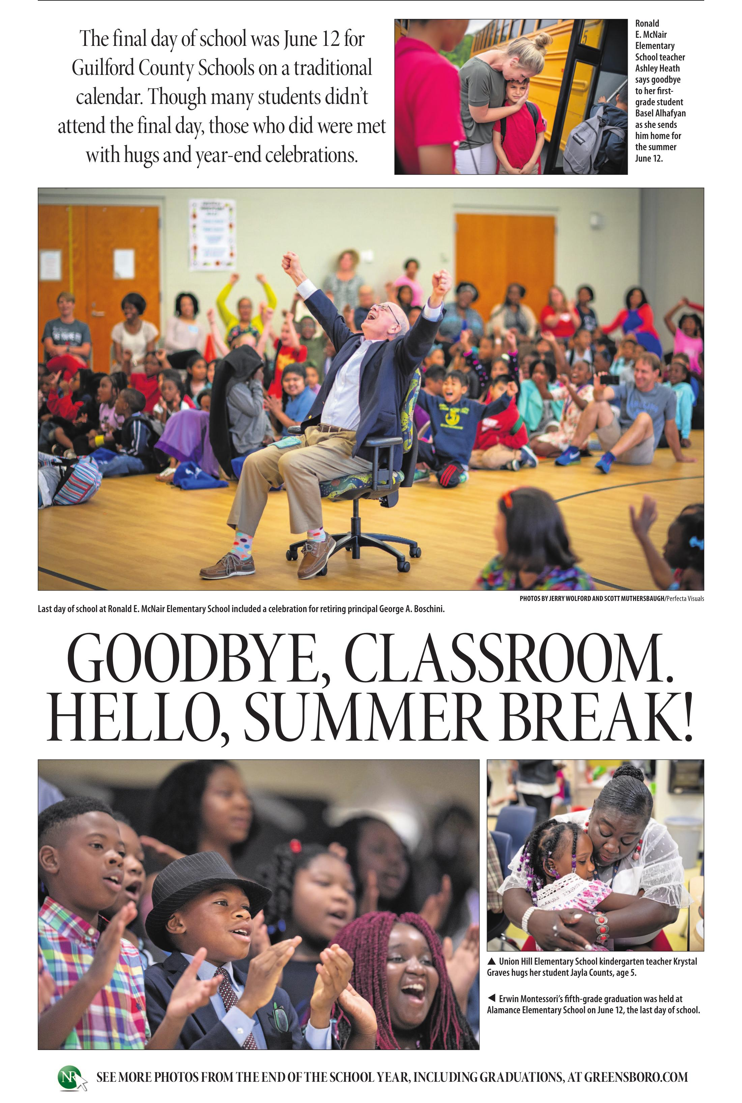
What’s working in GCS
COACH & BUILD CAPACITY
GET THERE FIRST
FOCUS ON THE WHY
CELEBRATE SUCCESS
REPEAT ACROSS CHANNELS

Slide 5
District-Level Engagement
Internal Key Communicators
Advisory Committees
Surveys
Focus Groups
Project Planning Teams

Slide 6
Communication Channels
Principal & Leader Toolkits
Staff meetings
IKC and Advisory Groups
Digital employee newsletter
Digital leadership newsletter
Superintendent messages
Website, GCSTV
Targeted emails, goodnews@gcsnc.com
Social media – Twitter, Facebook, YouTube, LinkedIn, Instagram
Special events
Mobile app
Media relations
Paid media, partnerships – Movie theaters, billboards, DMV

Slide 7
Recognizing employees
Employee of the Month
Board Meeting Recognitions
Celebration of Excellence
Retirement Celebration
Holiday luncheons, special celebrations
A-MAY-ZING GCS Month
Employee stories – website, social media, GCSTV, news media, targeted emails

Slide 8
May Recognition Blow-Out

Slide 9
New Teacher Signing Ceremony

Slide 10
Ongoing challenges – opportunities
Uneven communications and authentic engagement capacity among leaders at all levels = inconsistency, lower morale, lack of trust
Disconnects between messages and behaviors, lack of attention to symbolic communications
The ying and yang of streamlined communications – lack of “stickiness”
Too much pressure and not enough why and how
External morale busters courtesy of elected officials and other “experts” on education
Creating more powerful narratives – building storytelling skills
“On what high-performing companies should be striving to create: A great place for great people to do great work.” Marilyn Carlson

Slide 11
RESULTS

Slide 12
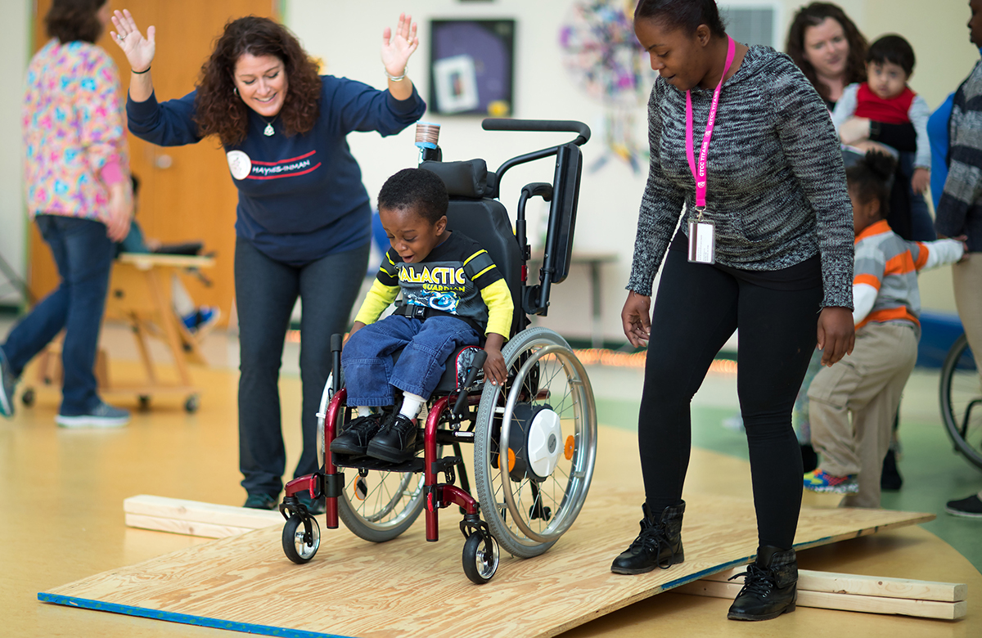
Dispirited, unmotivated, unappreciated workers cannot compete in a highly competitive world.”
Francis Hesselbein
RESULTS

Slide 13
QUESTIONS & ANSWERS

